Slide 1

Lessons from the COVID-19 Pandemic: Accelerating Inevitable and Desirable Agri-food Value Chain Innovations
Chris Barrett
Cornell University
American Geophysical Union Fall Meeting
December 16, 2020

Slide 2
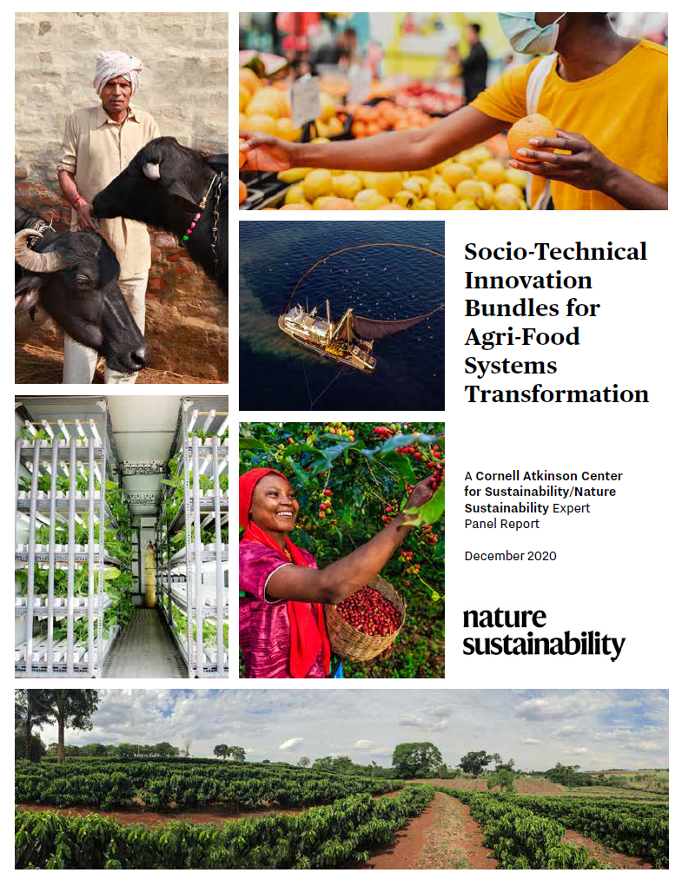
13 key lessons
So what are the key pandemic lessons for agri-food systems transformation?
Based on the Cornell Atkinson – Nature Sustainability 2020 expert panel on “Innovations to Build Sustainable, Equitable, Inclusive Food Value Chains”, released Dec. 10.

Slide 3
The COVID pandemic shock differs from 2008-11 or most other food system shocks
COVID and food systems
No significant supply shock to primary production.
The pandemic has wrought instead a massive:
(i) disruption to livelihoods, thus a demand shock;
(ii) food value chain shock through disruptions to (a) transport, (b) food service industries, and (c) some intermediary nodes (e.g., meatpacking), which have disrupted prices/flows within distinct chains.
Both a caution and an accelerator for agri-food systems transformation

Slide 4
Stuff happens! Be ready
Key lesson #1
Not a one-off, short-run shock
Won’t be the last major challenge of our lifetimes
Prepare for more severe, frequent, cascading shocks
Need greater resilience – incl. redundancy – in AFS

Slide 5
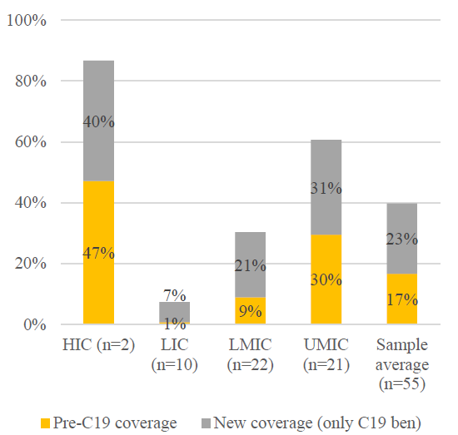
Need every-ready safety nets
Key lesson #2
People need assurance of protection. Otherwise, high human costs, aggravating pre-existing inequities, plus social solidarity/cooperation lag, stability at risk.
Can’t build reliable, scalable programs on the fly. Social protection upscaling has been strong, but coverage w/n LICs remains anemic.
Overwhelmingly cash transfers.
Source: Gentilini et al. World Bank

Slide 6
Beware slower-moving catastrophes
Key lesson #3
Fast-moving shocks compel policymaker attention
Beware slower moving, but equally consequential shocks: climate change, biodiversity/habitat loss, sea level rise
Slower transition too often engenders complacency
We must act now on slower-moving changes that will be equally catastrophic if we don’t prepare.

Slide 7
Massive resources can be mobilized quickly
Key lesson #4
Trillions of $ mobilized by governments in a few months.
Even more private $ available, both donations and investment. Interest rates are low, companies/investors are flush w/cash. Invest now!
Must get incentives right: advanced market commitments, benevolent patent extensions, landscape bonds, etc.

Slide 8
Move beyond uninsured cost minimization
Key lesson #5
Affordable, healthy diets are important for equity.
But uninsured risk is a (too often hidden) cost.
De-risking AFS requires greater diversification of production, sourcing, processing, and distribution patterns to enhance flexibility and redundancy.
De-risk to insure against catastrophic systemic risks.
Prevention ex ante cheaper than coping ex post.

Slide 9
Beware de-globalization
Key lesson #6
Many gov’ts indulge populist instincts towards self-sufficiency in response to supply chain disruptions.
That carries big risks:
Harm the poor by making food more expensive
Hurt environmental/climate sustainability b/c how a product is produced, processed and distributed matters far more to its env’t footprint than where it was made.
Trade increasingly essential to manage climate change.
Build resilience and diversify, but beware hidden nationalist agendas!

Slide 10
7. Fund and trust first rate science
8. Barriers to success more behavioral than scientific
9. Clear, consistent, trusted incentives/norms are key
10. Communication, transparency and cooperation are essential
11. Dramatic, fast improvements are possible
12. Treat underlying causes, not just symptoms
13. Need high-frequency monitoring
Other key lessons

Slide 11
The pandemic experience is accelerating agri-food innovations … mostly good
Innovations implications
Social protection innovations: safety nets essential
Robotization: routine but dangerous work
Meat substitutes: decoupling food production from land
Traceability: capture consumer WTP for foods’ credence env’t/health/social justice attributes

Slide 12
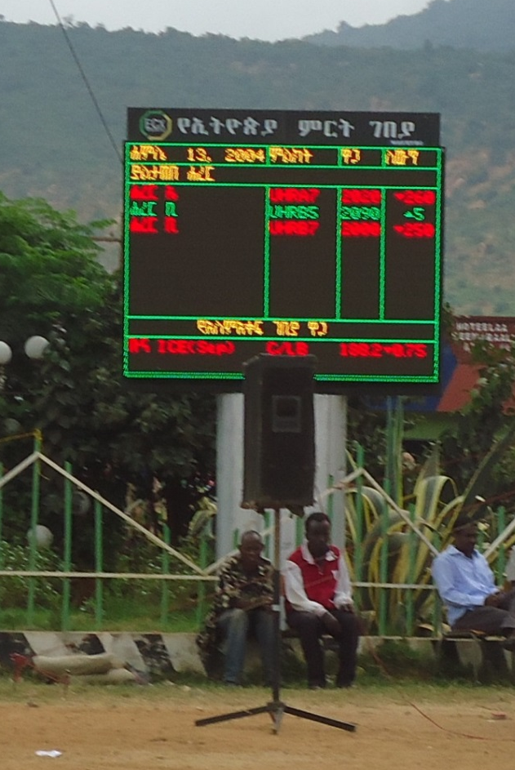
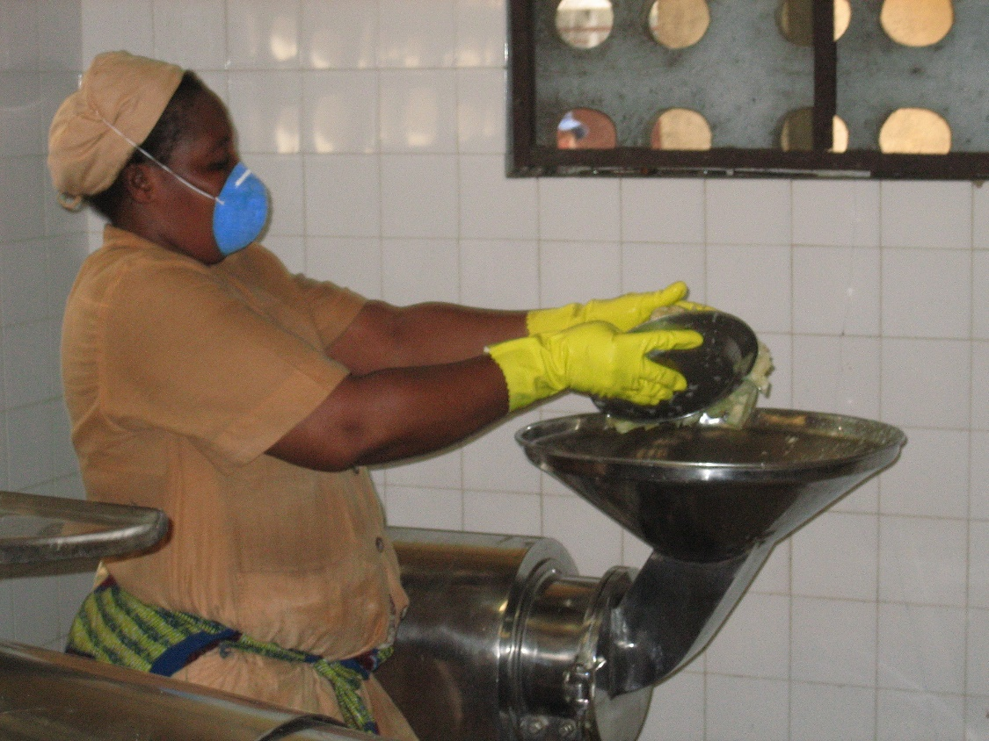
Thank you for your interest

